Slide 1
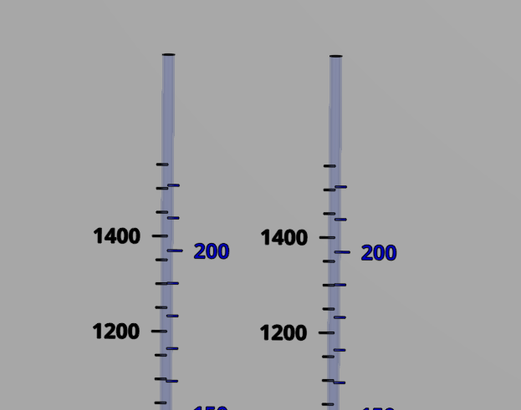
Coagulant
Chlorine
Stock tank
(L)
Calibration column
(mL)
Stock tank
(L)
Calibration column
(mL)

Slide 2
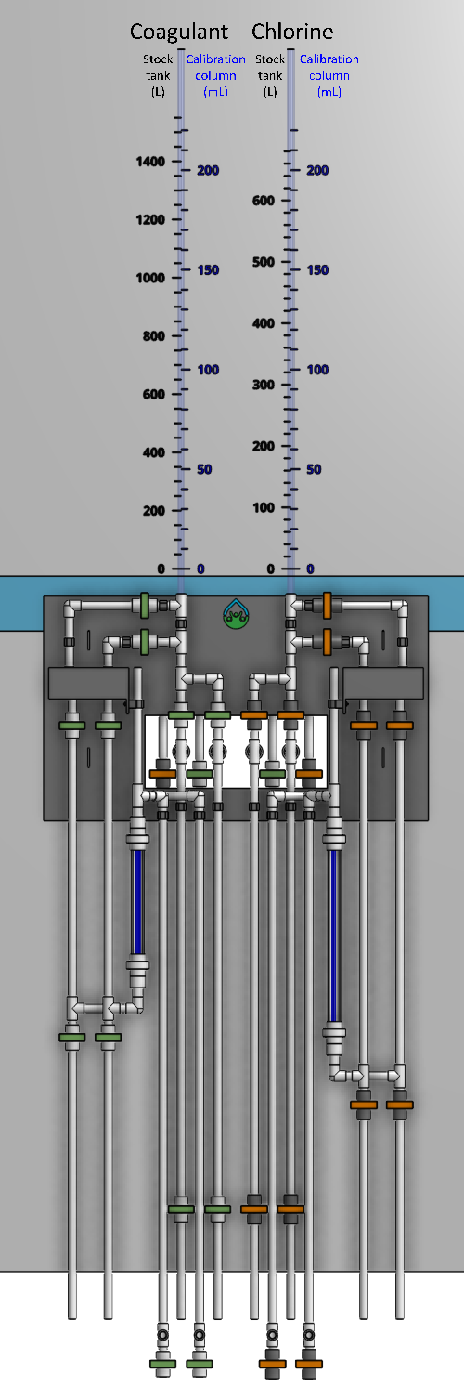

A
B
C

Slide 3
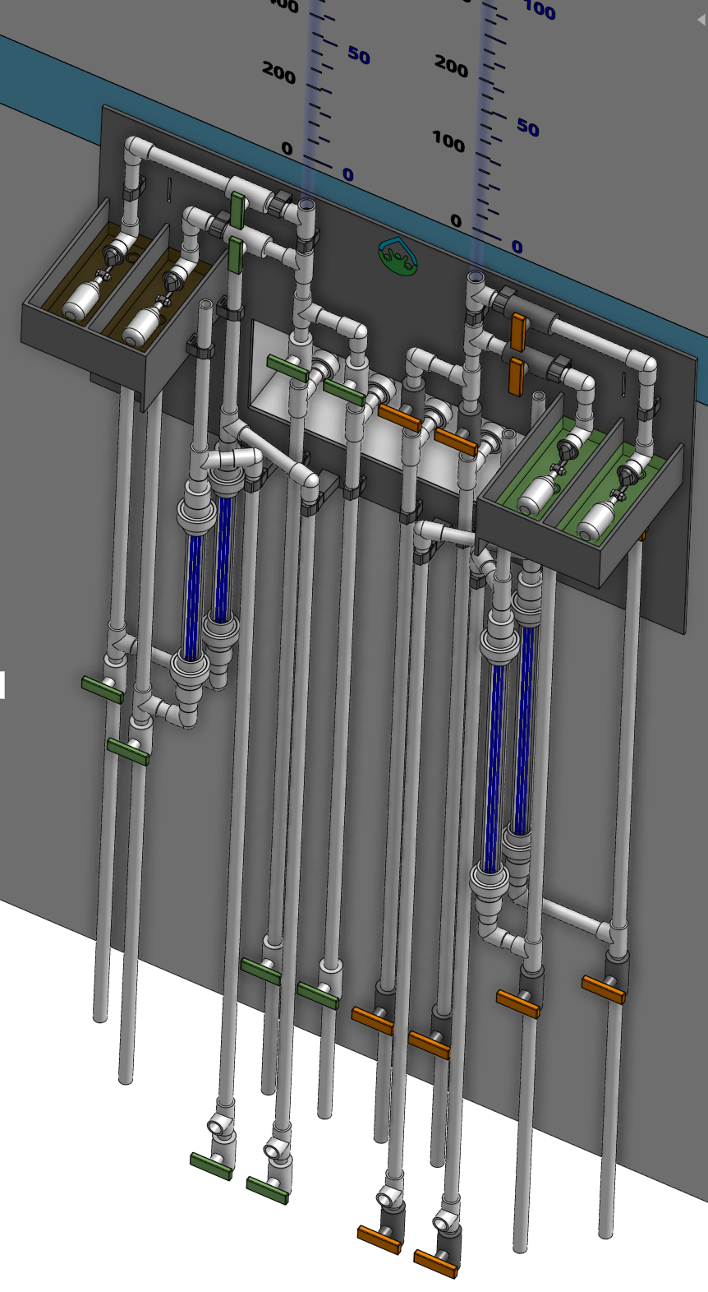
A
B
C
D
E
F
G
H
I
J
K
L

Slide 4


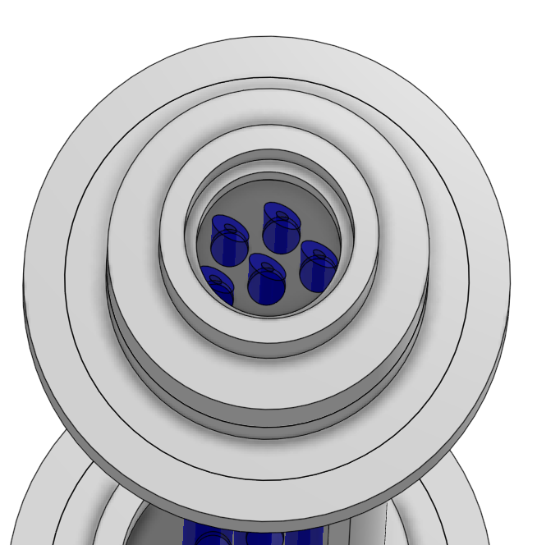
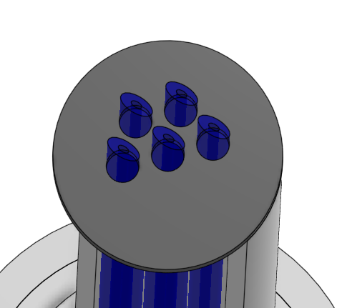
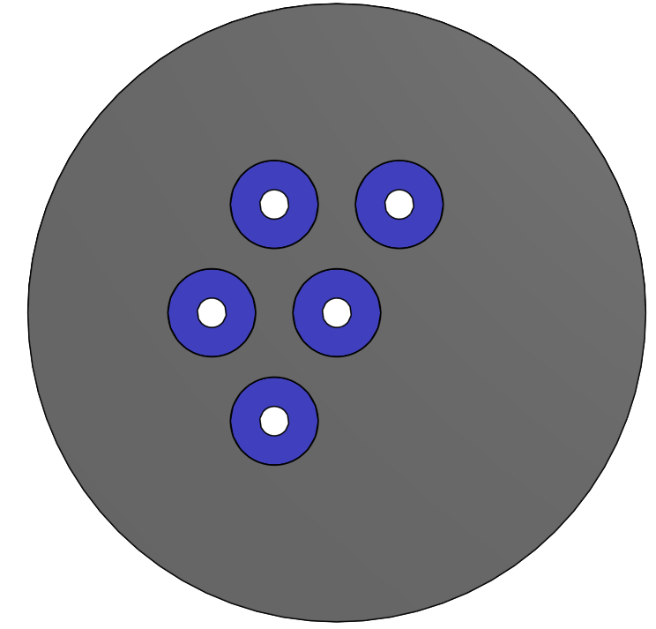
A
B
F
G
C
D
F
E
F
D

